Slide 1
The Need for Propagating Acknowledgments
Data Structures Week 1
Can I tell that all processes are aware that D has progressed beyond time t using vector clocks? No !!
Nodes need this information to determine when it is safe to discard/stabilize updates.

Slide 2
Matrix Time
Data Structures Week 1
In the system of matrix clocks, the time is represented by a set of n x n matrices of non-negative integers.
A process p_{i} maintains a matrix mt_{i}[1..n, 1..n] where, mt_{i} [i, i] denotes the local logical clock of p_{i} and tracks the progress of the computation at process p_{i}.
mt_{i}[i, j] denotes the latest knowledge that process p_{i} has about the local logical clock, mt_{j}[j, j], of process p_{j}. Mt[i,*] is vector vt_{i}
mt_{i}[j, k] represents the knowledge that process p_{i} has about the latest knowledge that p_{j} has about the local logical clock, mt_{k}[k, k], of p_{k} .
The entire matrix mt_{i} denotes p_{i}’s local view of the global logical time.

Slide 3
Matrix Time
Data Structures Week 1
Process p_{i} uses below rules to update its clock:
Rule 1 : Before executing an event, process p_{i} updates its local logical time as follows:
mt_{i}[i, i] := mt_{i} [i, i] + d (d > 0)
Rule 2: Each message m is piggybacked with matrix time mt. When p_{i} receives such a message (m,mt) from a process p_{j}, then p_{i} executes the below sequence:
  Update its global logical time as follows:
    (a) 1 ≤ k ≤ n : mt_{i}[i, k] := max(mt_{i}[i, k], mt[j, k]) (That is, update its row mt_{i}[i,∗] with the p_{j}’s row in the received timestamp, mt.)
    (b) 1 ≤ k, l ≤ n : mt_{i}[k, l] := max(mt_{i}[k, l], mt[k, l])
  Execute Rule 1.
  Deliver message m

Slide 4
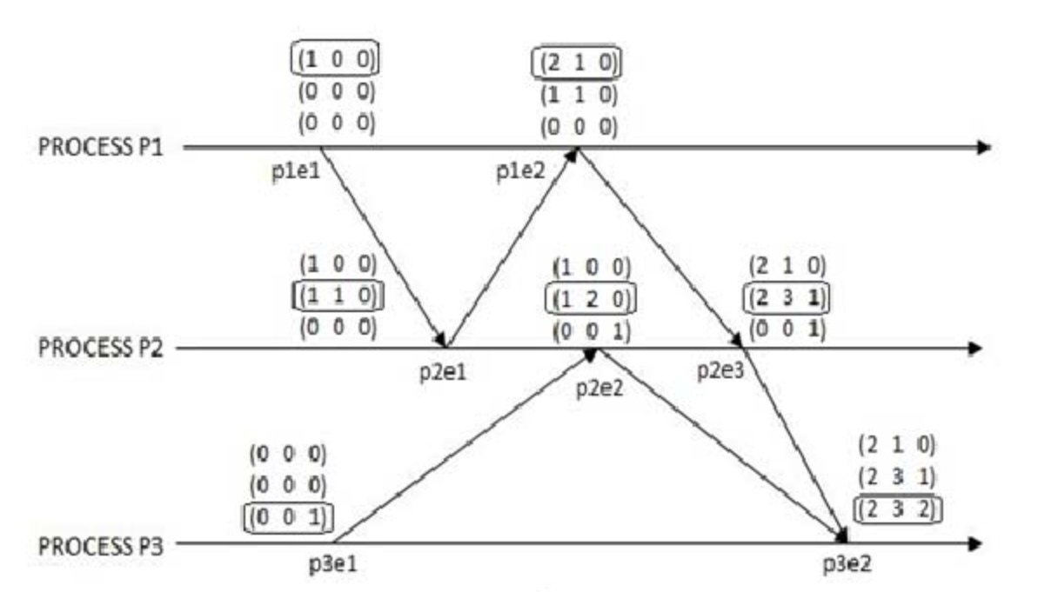
Data Structures Week 1
1
Notes:
P2’s second time matrix had error. The second vector in the matrix should be 121 and not 12 0

Slide 5
Teasers revisited using matrix clocks
Data Structures Week 1
HW
Can I know whether a broadcast sent by D using matrix clocks has reached everyone using causal msgs?

Slide 6
Global State
Data Structures Week 1
A Snapshot of the distributed application, i.e. a global picture is useful
○ Checkpointing: can restart distributed application on failure
○ Garbage collection of objects: objects at servers that don’t have any other objects (at any servers) with pointers to them
○ Deadlock detection: Useful in database transaction systems
○ Termination of computation: Useful in batch computing systems like Folding@Home, SETI@Home

Slide 7
Global State of a Distributed System
Can not stop the process and see the global snapshot and neither can we synchronise all the systems and ask them to take a snapshot at a particular instant.
Not necessary a state the system has visited but is one state that the system could have visited
We need to know both node and channel states as some msgs might be in transit

Slide 8
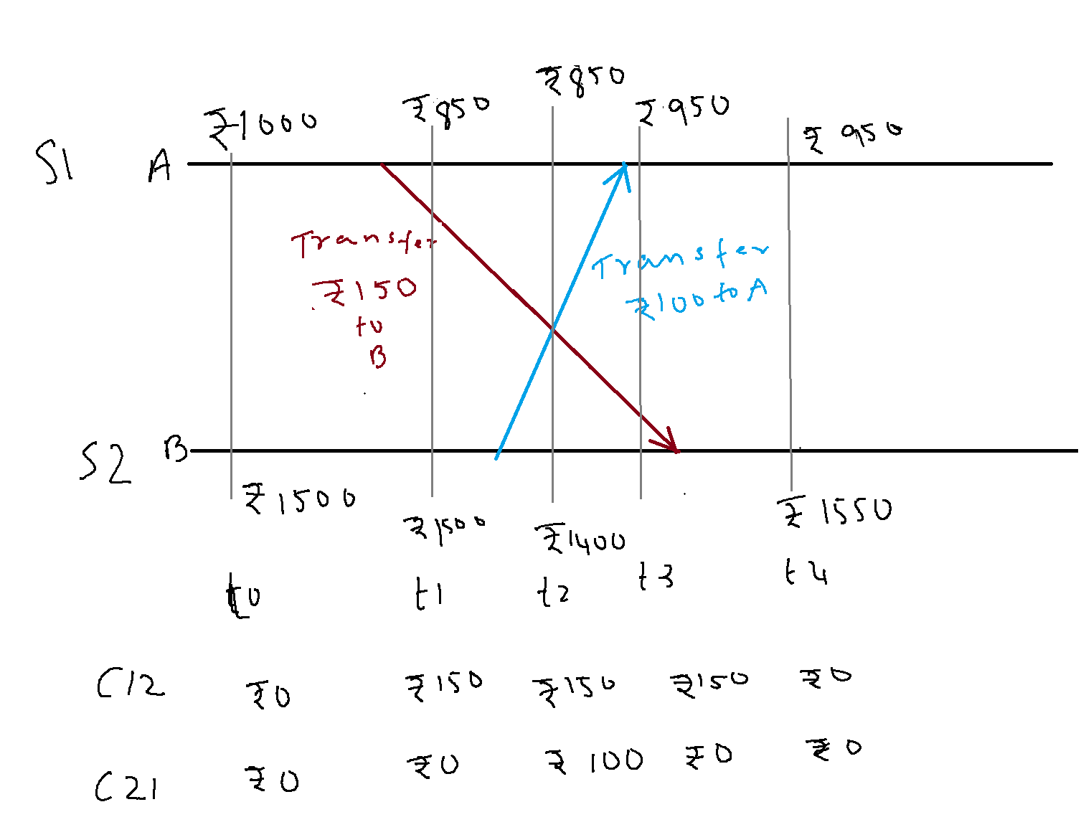
Global States and Snapshots
Consider the distributed execution shown above.

Slide 9
Global States and Snapshots
If the state of the account A is recorded at time t0 and the state of account B and that of the channels C12 and C21 are recorded at t2, what is the total money in the system?
What about t1 for S1 and t2 for rest?

Slide 10
Global States and Snapshots
Initially 1000+1500=2500
At check point 1000(A) +1400(B)+150(C₁₂)+100(C₂₁)= 2650
If this state is used for checkpointing, then there is trouble!
Something sent after state recorded is being considered in transit!
An extra 150 Rs !!!.

Slide 11
Global State of a Distributed System
One can think of the collection of local states as the global state.
Recall that the local state of a process, P_{i}, is the contents of the processor registers, stack, local memory, etc.
The state of a channel is the set of messages in transit in the channel.
Events lead to changes in the state of local process(es).

Slide 12
Global States and Snapshots
Recording the global state of a distributed system on-the-fly is an important paradigm.
The lack of globally shared memory, global clock and unpredictable message delays in a distributed system make this problem non-trivial.
Building on the definition consistent global states we discuss issues to be addressed to obtain consistent distributed snapshots.
Then several algorithms to determine on-the-fly such snapshots are presented for several types of networks.

Slide 13
Global State of a Distributed System
At any instant the state of a process Pi denoted by LS_{i}, is a result of the sequence of all events executed by p_{i} upto that instant. State of a Channel C_{ij} is denoted as SC_{ij}
The msgs in transit on the channel C_{ij} are denoted as
SC_{ij} ={m_{ij} | send (m_{ij}) ∈ LS_{i} and rec(m_{ij}) ∉LS_{j}}
To formalize, let LS^{x}_{i} denote the local state of process P_{i} after the occurrence of all events until event e^{x}_{i}
  LS⁰_{i} is the initial state of P_{i}

Slide 14
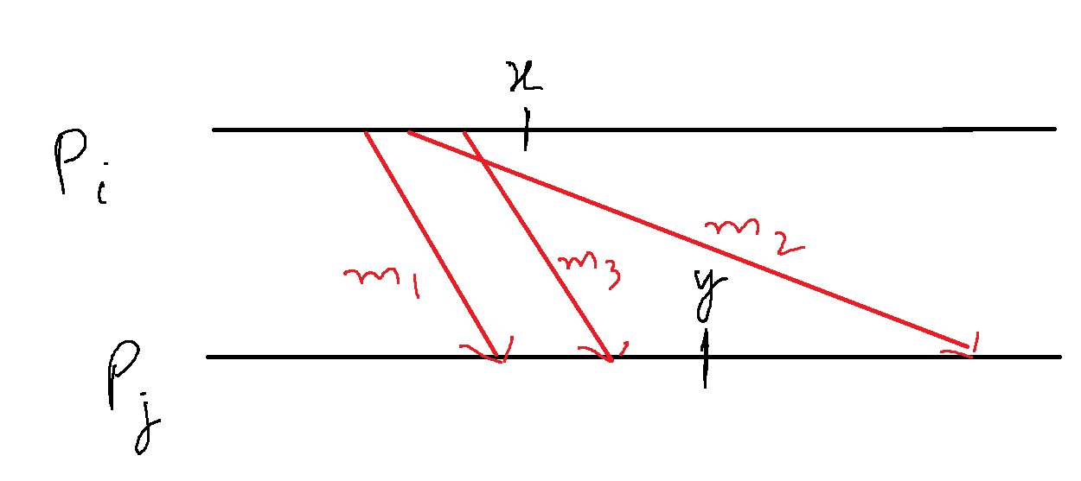

Global State of a Distributed System
We use the above to capture the state of a channel C_{ij}, denoted SC^{x,y}_{i,j} as follows.
  SC^{x,y}_{i,j} = {m_{ij} | send(m_{ij}) <= LS^{x}_{i} and recv(m_{ij}) LS^{y}_{j}}
In words, the state of SC^{x,y}_{i,j} denotes all messages that have been sent by P_{i} up to event e^{x}_{i} and not received by P_{j} up to event e^{y}_{j}.

Slide 15
Conditions for Consistent Global States
The global state of a distributed system is a collection of the local states of the processes and the channels.
Notationally, global state GS is defined as,
  GS = { U_{i}LS_{i} , U_{i,j} SC_{ij}}
A global state GS is a consistent global state iff it satisfies the following two conditions :
C1: send(m_{ij})∈ LS_{i} ⇒ m_{ij} ∈ SC_{ij} ⊕ rec(m_{ij})∈LS_{j}. (⊕ is the Exclusive-OR operator)
C2: send(m_{ij})∉ LS_{i} ⇒ m_{ij} ∉ SC_{ij} Ʌ rec(m_{ij}) ∉ LS_{j}.

Slide 16
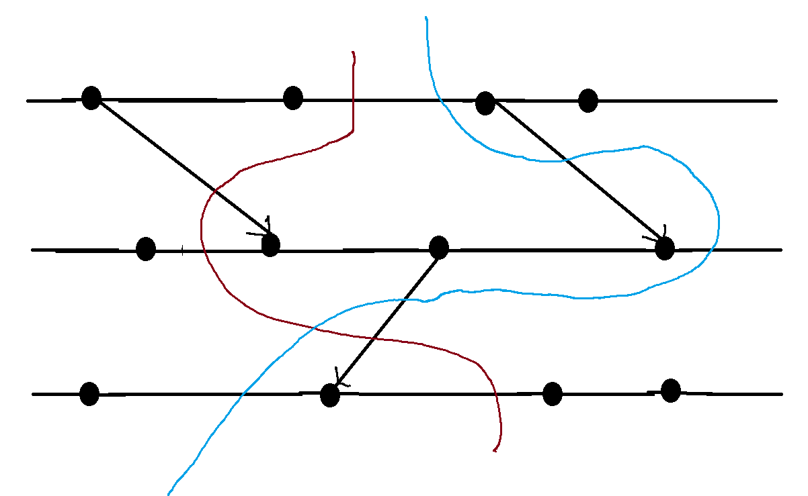
Interpretation in terms of cuts
A cut in a space-time diagram is a line joining an arbitrary point on each process line that slices the space-time diagram into a PAST and a FUTURE.
A consistent global state corresponds to a cut in which every message received in the PAST of the cut was sent in the PAST of that cut.
Such a cut is known as a consistent cut.

Slide 17
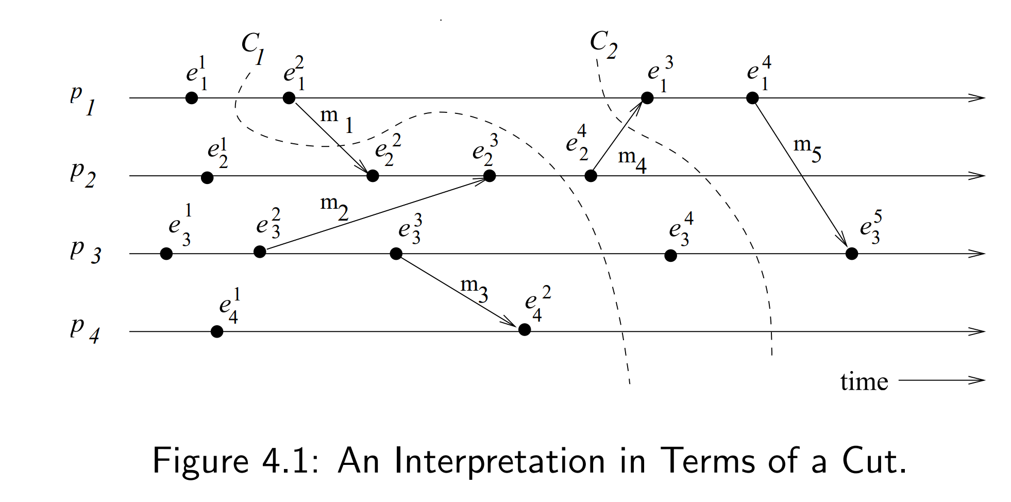
Interpretation in terms of cuts – Example
Cut C₁ is inconsistent because message m₁ is flowing from the FUTURE to the PAST.
Cut C₂ is consistent and message m₄ must be captured in the state of channel C₂₁.

Slide 18
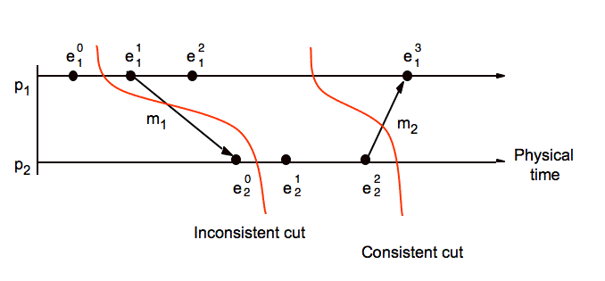
Consistent and Inconsistent Cut

Slide 19
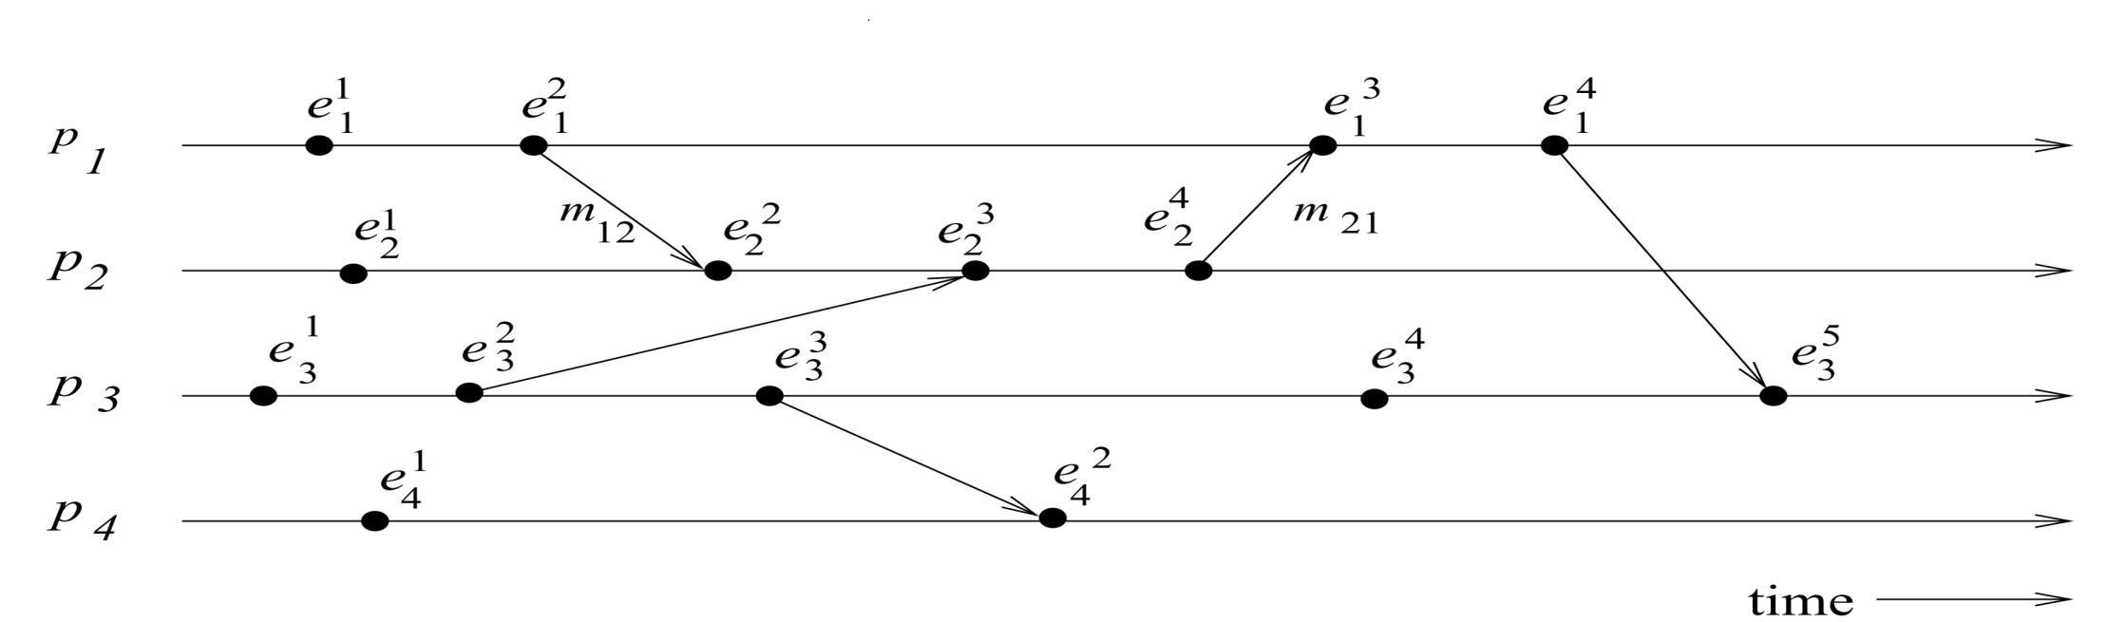
Example
Which global states are consistent?
{LS¹₁, LS³₂, LS³₃, LS²₄}
{LS²₁, LS⁴₂, LS⁴₃, LS²₄}
{LS²₁, LS¹₂, SC²²₁₂, LS³₃, LS²₄} (certain channels are missing here)
  SC^{x,y}_{i,j} = {m_{ij} | send(m_{ij})<= LS^{x}_{i} and recv(m_{ij}) LS^{y}_{j}}

Slide 20
Example
Which global states are consistent?
{LS¹₁, LS³₂, LS³₃, LS²₄} -inconsistent
{LS²₁, LS⁴₂, LS⁴₃, LS²₄} - consistent
{LS²₁, LS¹₂, SC²²₁₂, LS³₃, LS²₄} - consistent
  SC^{x,y}_{i,j} = {m_{ij} | send(m_{ij})<= LS^{x}_{i} and recv(m_{ij}) LS^{y}_{j}}

Slide 21
Identify consistent states
Is s1 at t1, s2 at t2, and both channels at t2 consistent ?
--if so this is also a global state though not a global state in reality

Slide 22
Difficulty of Taking a Snapshot
Issue 1: How to distinguish between the messages to be recorded in the snapshot from those not to be recorded.
  Any message that is sent by a process before recording its snapshot, must be recorded in the global snapshot (from C1).
  Any message that is sent by a process after recording its snapshot, must not be recorded in the global snapshot (from C2).
Issue 2: How to determine the instant when a process takes its snapshot.
    A process p_{j} must record its snapshot before processing a message m_{ij} that was sent by process p_{i} after recording its snapshot.

Slide 23
A Distributed Program in Execution
Let us now model message delivery.
Several ways are possible
  Non-FIFO : Message can be reordered in transit
  FIFO : Messages are NOT reordered in transit.
  Causal : Slightly stronger than FIFO. Messages destined for the same destination are not reordered. In symbols,
  for any two messages m_{ij} and m_{kj},
  if send(m_{ij}) → send(m_{kj}) then recv(m_{ij}) → recv(m_{kj}).
  Causal degenerates to FIFO when sent from same process.

Slide 24
Data Structures Week 1
Global Snapshots for FIFO channels
– Chandy lamports Algorithm

Slide 25
Chandy-Lamport’s Algorithm
Uses special marker messages.
One process acts as initiator, starts the state collection by following the marker sending rule below.
Marker sending rule for process P:
    P records its state and
    For each outgoing channel C from P on which a marker has not been sent already, P sends a marker along C before any further message is sent on C

Slide 26
Chandy Lamport’s Algorithm contd..
When Q receives a marker along a channel C:
  If Q has not recorded its state then Q records its state and also records the state of C as empty; Q then follows the marker sending rule
  If Q has already recorded its state, it records the state of C as the sequence of messages received along C after Q’s state was recorded and before Q received the marker along C
INDIAN INSTITUTE OF TECHNOLOGY KHARAGPUR
Notes:
Example Lecture 12:
https://www.youtube.com/watch?v=odBAt98e2mk&list=PLUJ7JmcrTifBROWODSG8wgyl20XgBuE-N&index=12
Time 15:58

Slide 27
Chandy Lamport’s Algorithm contd..
  If Q has already recorded its state, it records the state of C as the sequence of messages received along C after Q’s state was recorded and before Q received the marker along C
  Say a marker is received by Pj from say Pi where Pj has already recorded its state. Now there can be no messages sent from Pi to Pj from when Pi records the state to when Pi sends out the markers. Hence this msg received was sent before Pi marked its state and received after Pj marked its state. Thus, this msg belongs to the transit messages in Channel (Pi, Pj)
INDIAN INSTITUTE OF TECHNOLOGY KHARAGPUR

Slide 28
Notable Points
Markers sent on a channel distinguish messages sent on the channel before the sender recorded its states and the messages sent after the sender recorded its state
The state collected may not be any state that actually happened in reality, rather a state that “could have” happened
INDIAN INSTITUTE OF TECHNOLOGY KHARAGPUR

Slide 29
Notable Points
Markers sent on a channel distinguish messages sent on the channel before the sender recorded its states and the messages sent after the sender recorded its state
The state collected may not be any state that actually happened in reality, rather a state that “could have” happened
Will it work if not FIFO channels?
Message complexity ?
INDIAN INSTITUTE OF TECHNOLOGY KHARAGPUR

Slide 30
Chandy-Lamport algorithm – FIFO Channels
The Chandy-Lamport algorithm uses a control message, called a marker whose role in a FIFO system is to separate messages in the channels.
After a site has recorded its snapshot, it sends a marker, along all of its outgoing channels before sending out any more messages.
A marker separates the messages in the channel into those to be included in the snapshot from those not to be recorded in the snapshot.
A process must record its snapshot no later than when it receives a marker on any of its incoming channels.

Slide 31
Chandy-Lamport algorithm – FIFO Channels
The algorithm can be initiated by any process by executing the “Marker Sending Rule” by which it records its local state and sends a marker on each outgoing channel.
A process executes the “Marker Receiving Rule” on receiving a marker.
If the process has not yet recorded its local state, it records the state of the channel on which the marker is received as empty and executes the “Marker Sending Rule” to record its local state.

Slide 32
Termination Condition
The algorithm terminates after each process has received a marker on all of its incoming channels.
All the local snapshots get disseminated to all other processes and all the processes can determine the global state.

Slide 33
Correctness and Complexity
Correctness
Due to FIFO property of channels, it follows that no message sent after the marker on that channel is recorded in the channel state. Thus, condition C2 is satisfied.
When a process p_{j} receives message m_{ij} that precedes the marker on channel C_{ij} , it acts as follows: If process p_{j} has not taken its snapshot yet, then it includes m_{ij} in its recorded snapshot. Otherwise, it records m_{ij} in the state of the channel C_{ij} . Thus, condition C1 is satisfied.
Complexity
The recording part of a single instance of the algorithm requires O(e) messages.

Slide 34
Recorded Global State
Data Structures Week 1
Say S1 initiates right after t1.
This marker received by S2 after t4.
S2 marks its state and sends marker to S1.
Global State= 850(S1)+1550(S2) +
C12=0 (as when it received the marker
S2 had not marked its state) + C21=100 (msg
received btwn S1 marking its state and marker
received from S2)
Total=2500
Say S1 initiates right after t0.
This marker received by S2 after t2.
S2 marks its state and sends marker to S1.
This marker from S2 to S1 can reach only after msg with
transfer of Rs 100 (FIFO order)
Global State= 1000(S1)+1400(S2) +
C12=0 (as when it received the marker
S2 had not marked its state) + C21=100 (msg
received btwn S1 marking its state and marker
received from S2). Total=2500
Neither are true global states

Slide 35
Data Structures Week 1
Multiple processes can initiate the algorithm concurrently- Read page 94 (H.W)

Slide 36
Snapshot for non-FIFO Channels
In a non-FIFO system, a marker cannot be used to delineate messages into those to be recorded in the global state from those not to be recorded in the global state.
In a non-FIFO system, either some degree of inhibition or piggybacking of control information on computation messages to capture out-of-sequence messages.

Slide 37
The Lai-Yang Algorithm
uses coloring scheme on messages
Every process is initially white and turns red while taking a snapshot. It then sends a red msg to every other process.
Every message sent by a white (red) process is colored white (red).
Thus, a white (red) message is a message that was sent before (after) the sender of that message recorded its local snapshot.
Every white process takes its snapshot at its convenience, but no later than the instant it receives a red message

Slide 38
The Lai-Yang Algorithm
Every white process records a history of all white messages sent or received by it along each channel.
When a process turns red, it sends these histories along with its snapshot to the initiator process that collects the global snapshot.
The initiator process evaluates transit(LS_{i}, LS_{j}) to compute the state of a channel C_{ij.} HOW ?

Slide 39
The Lai-Yang Algorithm
Every white process records a history of all white messages sent or received by it along each channel.
When a process turns red, it sends these histories along with its snapshot to the initiator process that collects the global snapshot.
The initiator process evaluates transit(LS_{i}, LS_{j}) to compute the state of a channel C_{ij} as given below:
SC_{ij} = white messages sent by pi on C_{ij} − white messages received by pj on C_{ij}
C_{ij} = {send(m_{ij})|send(m_{ij}) ∈ LS_{i} } − {rec(m_{ij})|rec(m_{ij}) ∈ LS_{j} }.

Slide 40
The Lai-Yang Algorithm
What is the advantage of Lai-Yangs method over Chandy Laports ?
Issues ?
Notes:
Works on non fifo channels are well.

Slide 41
Data Structures Week 1
The Lai-Yang Algorithm works in case of non FIFO messages?
What about storage?

Slide 42
Data Structures Week 1
The Lai-Yang Algorithm works in case of non FIFO messages?
It does. Channel trasmit msgs are white msgs sent before snapshot and have not reached by the time other process has taken its snapshot. They are hence truly in transit and can reach in any order
Storage
Storage is heavy as each process has to remember all msgs he has sent received until snapshot

Slide 43
HW
Data Structures Week 1
How can you take a global snapshot assuming causal delivery order

